Slide 1
ACS 560 Course Project: UML Diagrams
Kevin Villela
Phillip Bercot

Slide 2
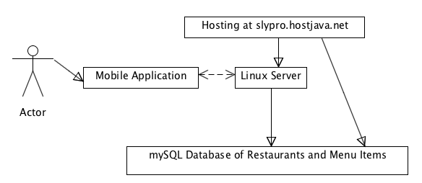
Major Modules
Notes:
Useful for others = an application that people might actually download.
Useful for us = another line on the resume. An app that has X downloads and is on the app store is something to show employers.
Interesting = As an athlete, it’d be great to have handy access to what is available on a restaurants menu.

Slide 3
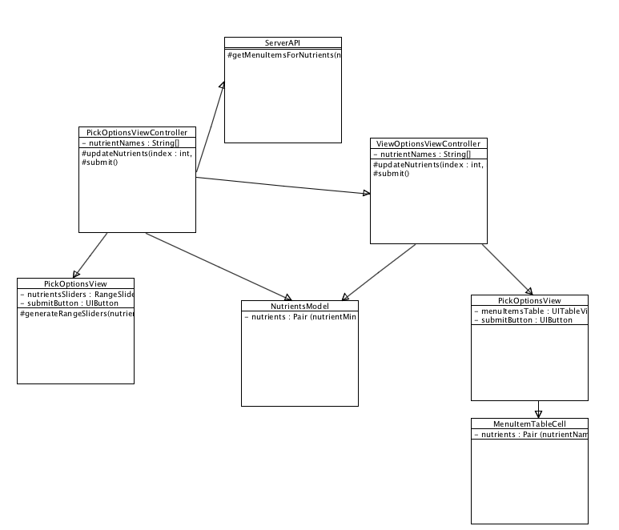
Client-Side Class Diagram
Notes:
The application must pass Apple’s application requirements to get on the Apple Application store.

Slide 4
Server-Side Class Diagram

Slide 5
Sequence Diagrams

Slide 6
Q&A
Any questions?

